Slide 1



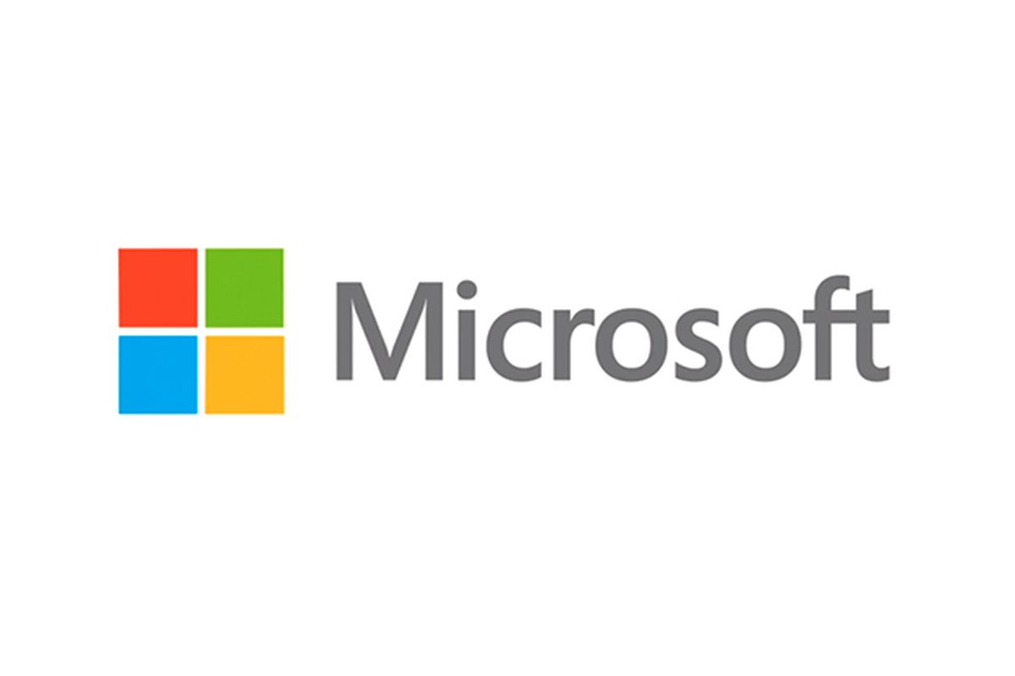
Introduction To C# Programming Language
About Author
Name : Tashik Moin Sheikh
University : National University Of Computer & Emerging Sciences, FAST-Karachi.
GitHub : TashikMoin23
Email : TashikMoinSheikh@Gmail.Com
Mobile : +92 3000 212027
Microsoft Student Partner

Slide 2
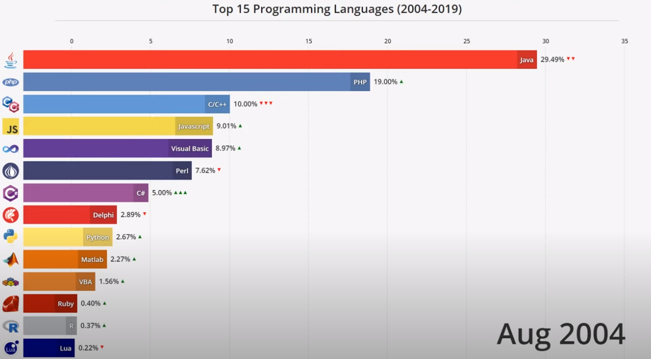
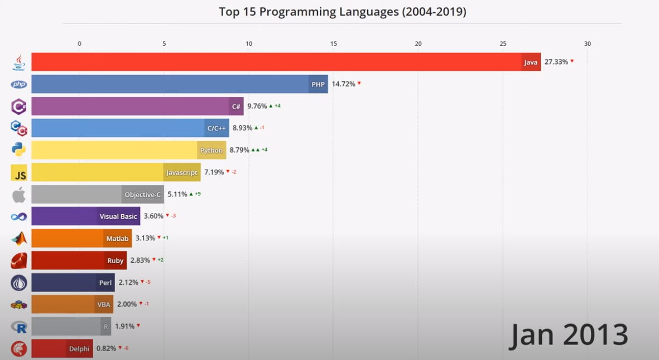
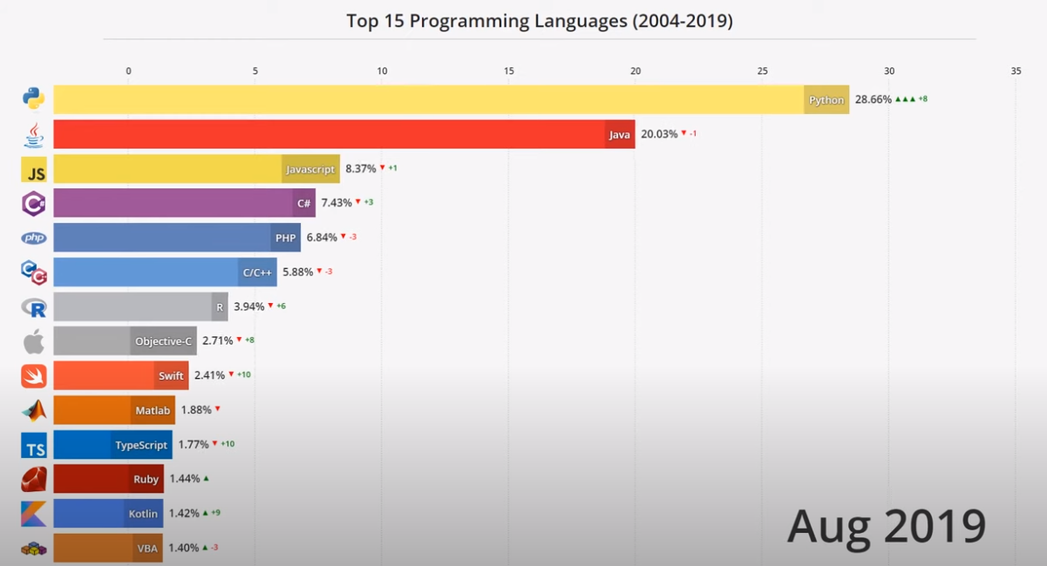
Top Programming Languages By Popularity

Slide 3
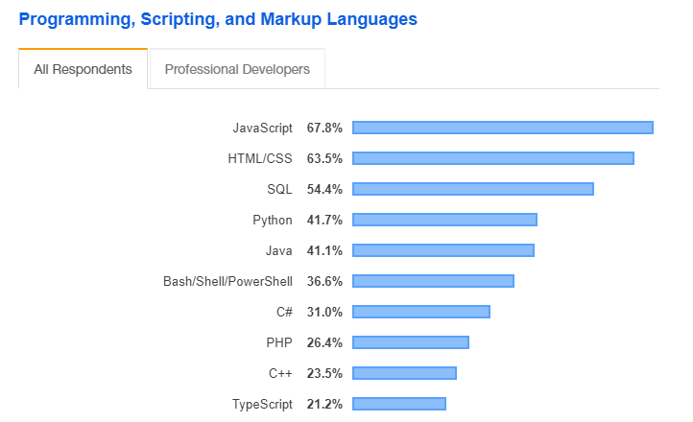
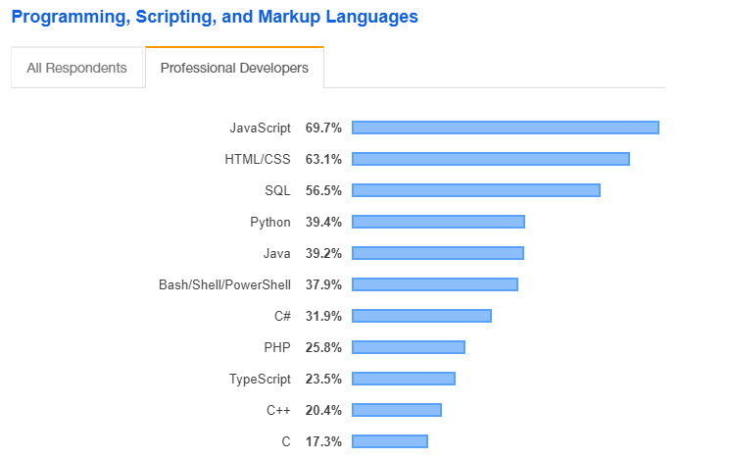
Top Programming, Scripting, & Markup Languages With Their Usage Percentage According To Stack Overflow Survey 2019

Slide 4
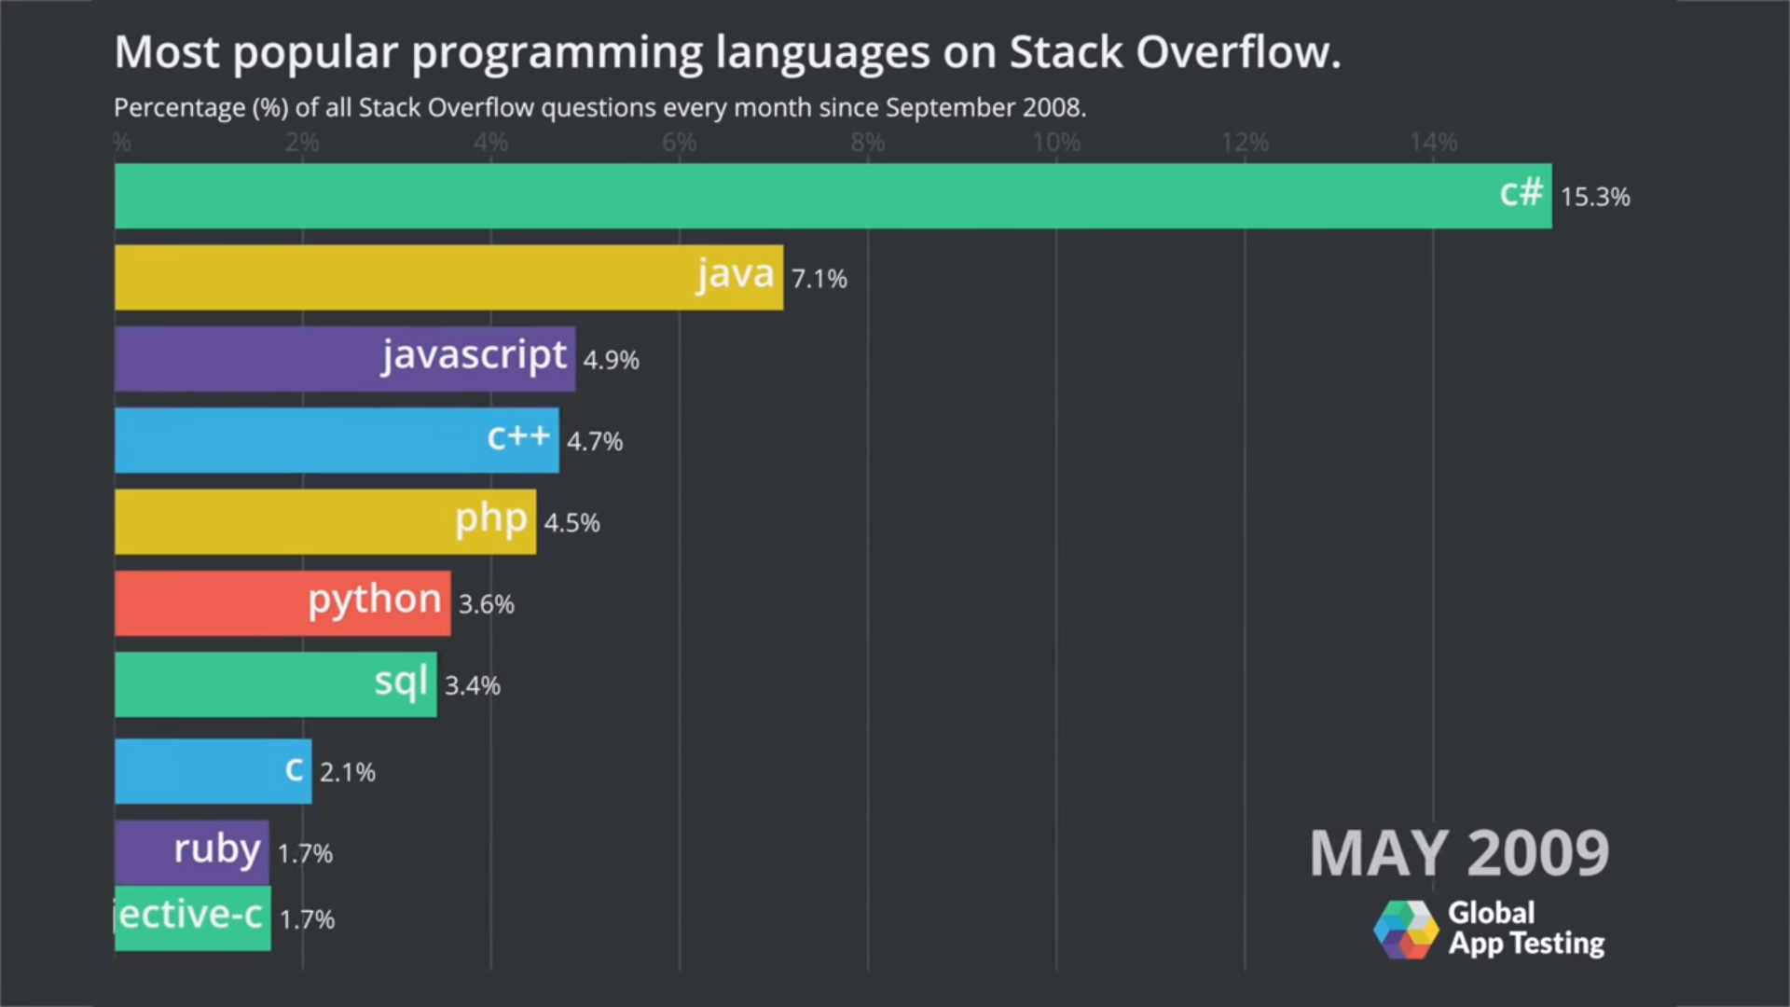
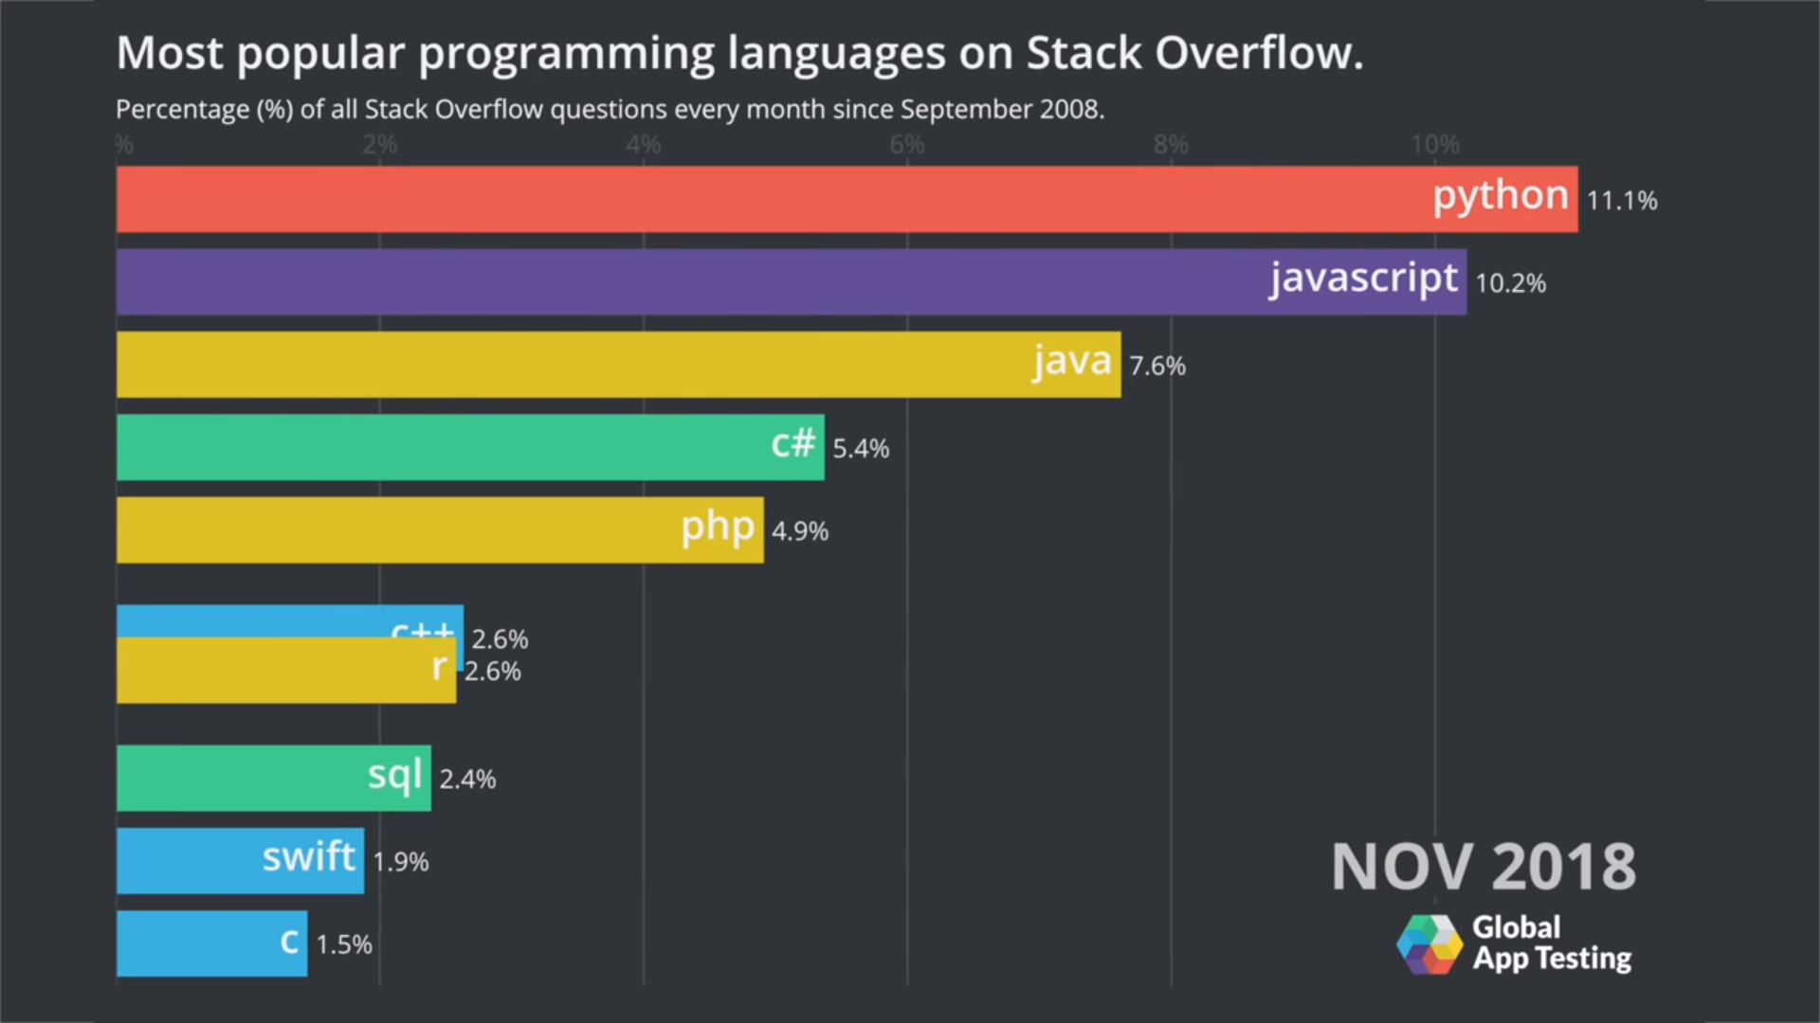
Most Popular Programming Languages On Stack Overflow

Slide 5
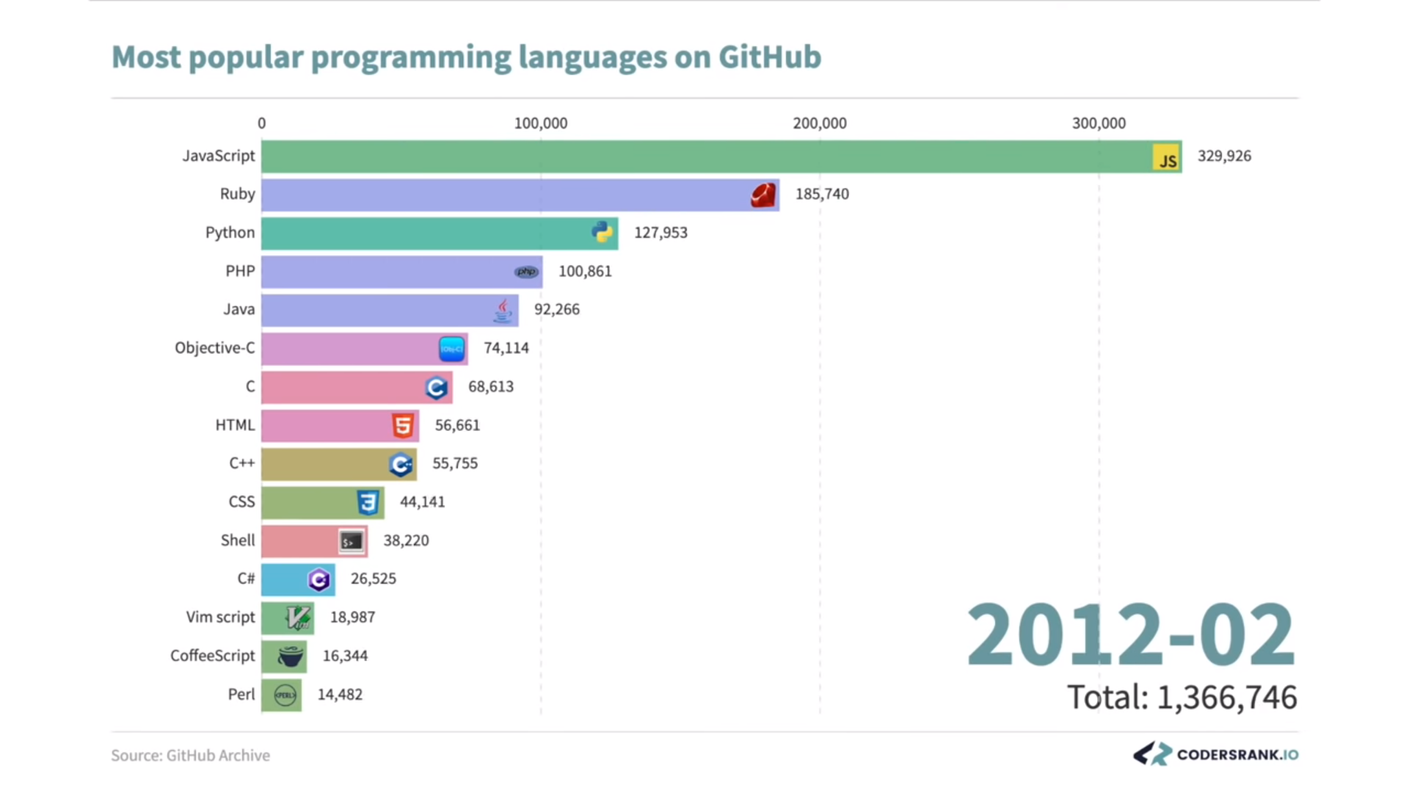
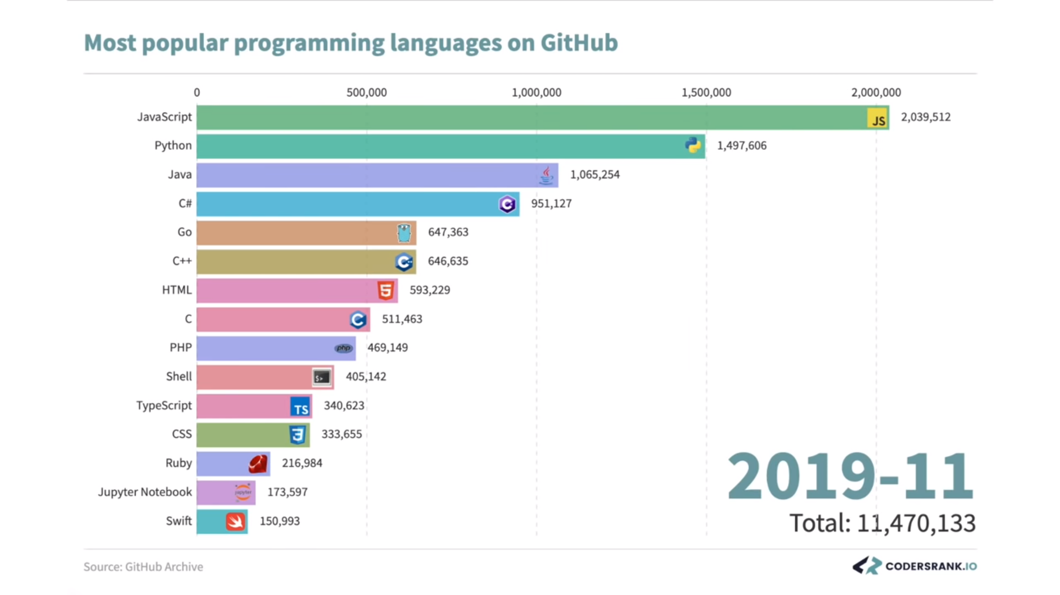

Slide 6
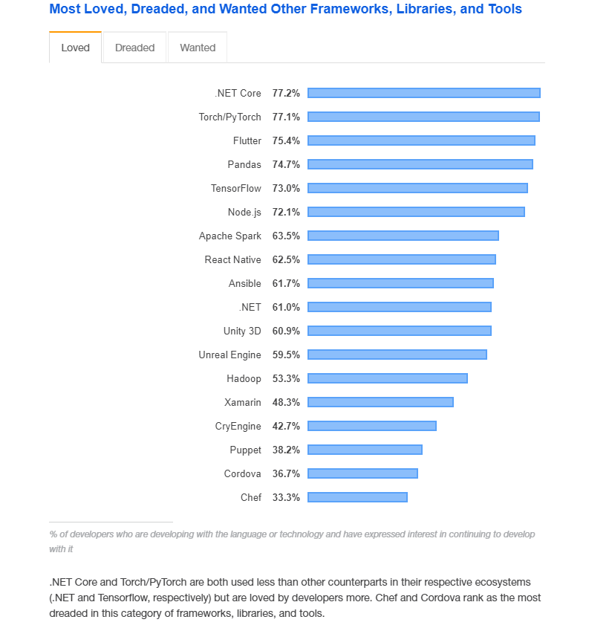
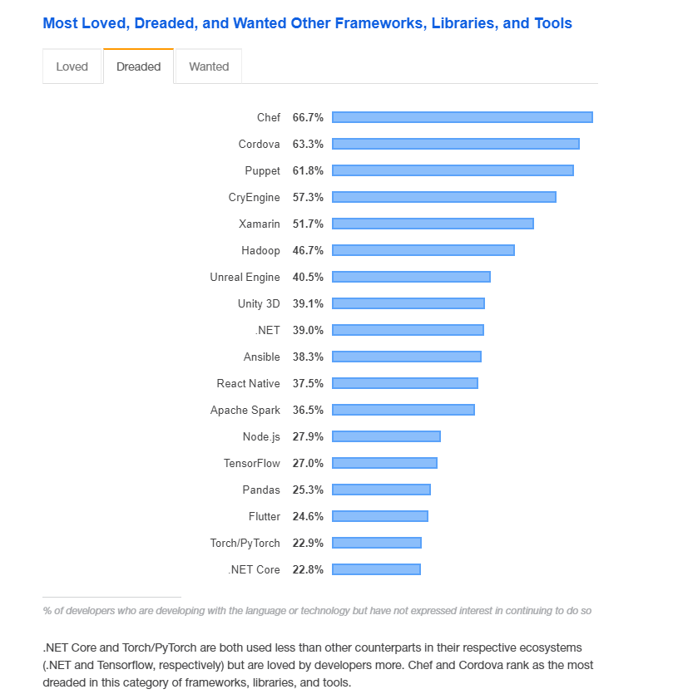
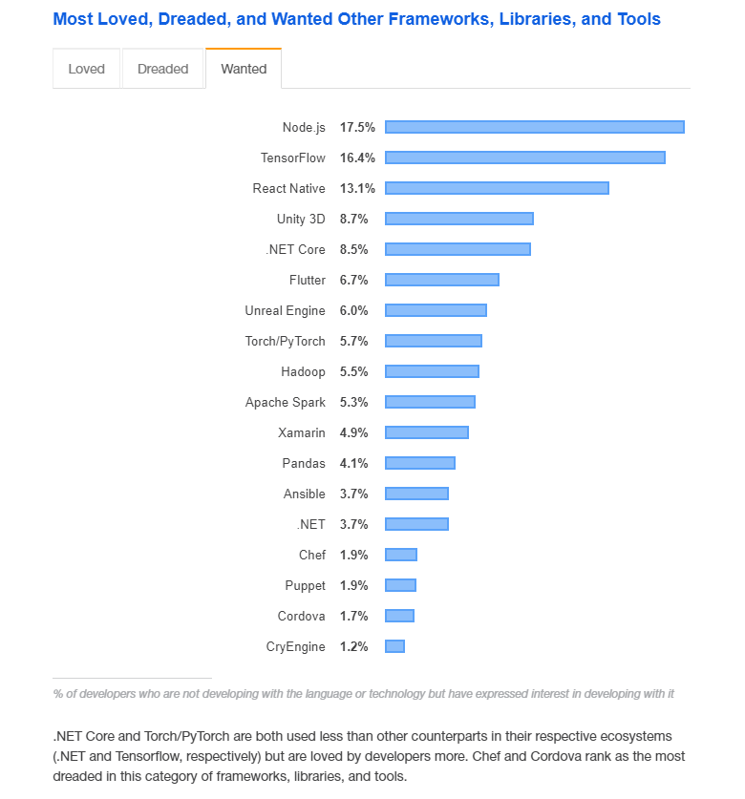
Loved, Dreaded, & Wanted Frameworks, Libraries & Tools According To Stack Overflow 2019 Survey

Slide 7
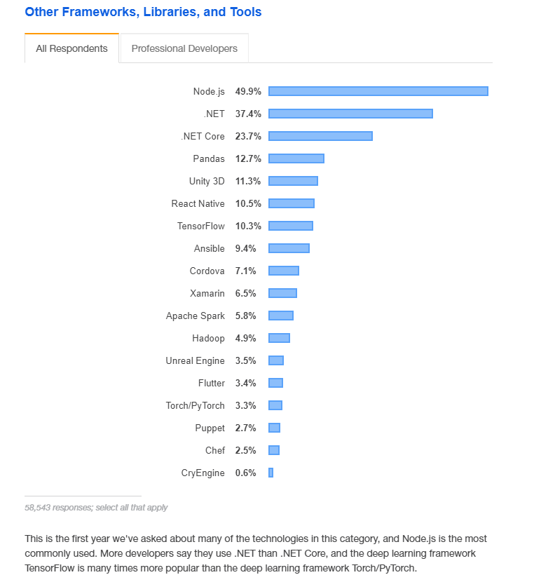
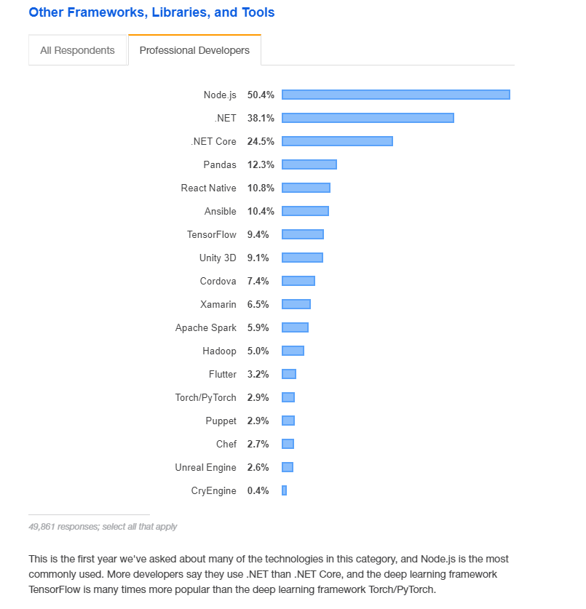
Most Used Frameworks, Libraries & Tools According To Stack Overflow Survey 2019

Slide 8
Introduction To .NET And .NET Core Frameworks
.NET Framework is a software framework developed by Microsoft that runs primarily
on Windows OS. It includes a large class library called Framework Class Library - FCL & provides
Language interoperability that means each language can use code written in other languages.
.NET Core is a cross-platform .NET implementation for websites, servers, and console apps on Windows, Linux, and macOS.

Slide 9


Slide 10


Slide 11
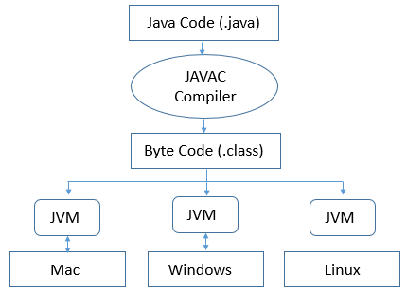
Java Code Compilation Process

Slide 12


Slide 13

.NET & C# Compilation Process

Slide 14



Slide 15
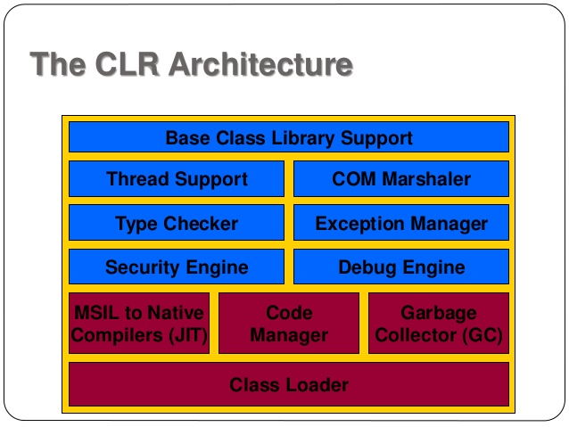
Components Of CLR

Slide 16
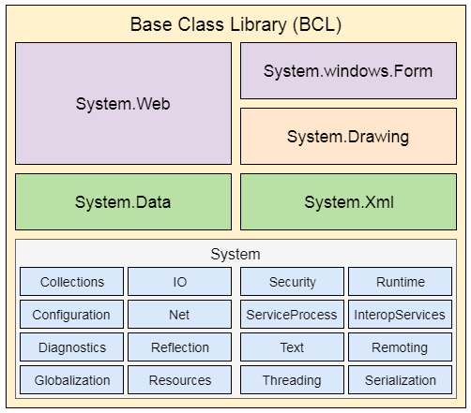
.NET Base Class Library
.NET Base Class Library is the sub part of the Framework that provides library support to Common Language Runtime to work properly. It includes the System namespace and core types of the .NET framework.

Slide 17
Why One Should Learn C# In 2020 ?
C# is a primary programming language for any new Microsoft product and platform.
C# fully supports trending bleeding-edge technologies development such as Artificial Intelligence, Machine Learning, Blockchain,
Internet of Things, and Intelligent Cloud.
Enterprise Cross-Applications Development
Visual Studio versions provide a complete suite of tools to build cloud applications for Windows Azure. Windows Azure is Microsoft's
operating system for cloud computing and hosting. Using Visual Studio, not only you can build Azure solutions but can also deploy and manage
them. C# can also be used to work with SQL Azure, the cloud version of Microsoft's SQL Server database server.
Cross platform mobile application with Xamarin. Xamarin is a framework that allows developers to make cross platform mobile applications
just like flutter. According to Stack Overflow 2019 survey, it’s usage in 2019 was 6.5% whereas flutter had only 3.4%.
Universal Windows Platform (UWP) Apps are windows apps run on Windows 10 or later platforms.
Cross Platform Web Applications using ASP.NET Core.
Universal Windows Platform (UWP) Apps are windows apps run on Windows 10 or later platforms.
Windows Services, Web Services, and Web APIs.
Efficient Game Development with Unity Engine.
Artificial Intelligence with ML.NET
IOT with ARM32 & ARM64
Many More..

